Slide 1
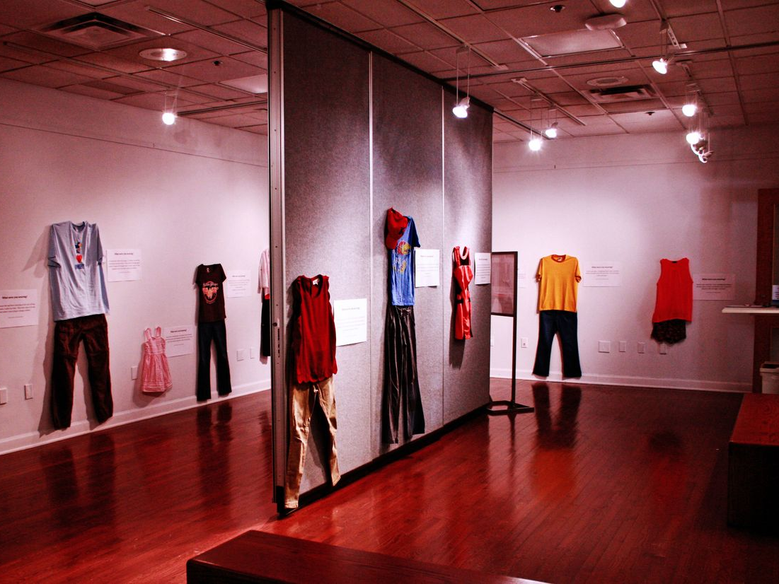
Exhibition 'What Were You Wearing?'

Slide 2
1. Repent
2. Receive
3. Get Rid
4. Relate
5. Be Refilled

